Slide 1


Slide 2
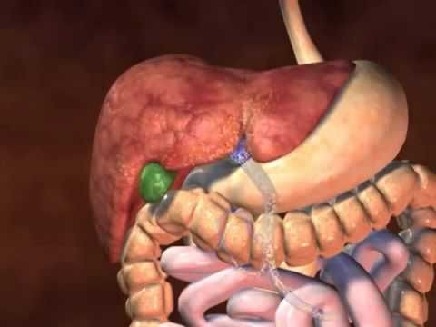
Surgery of Liver and Biliary System
By Dr. Rafid Majeed Naeem Alkhalifa

Slide 3
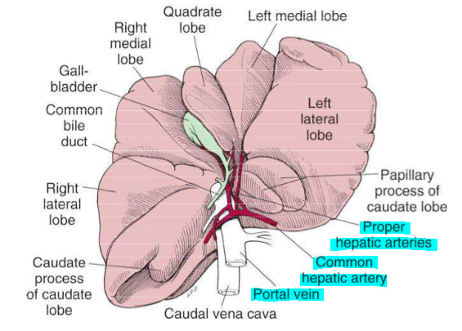
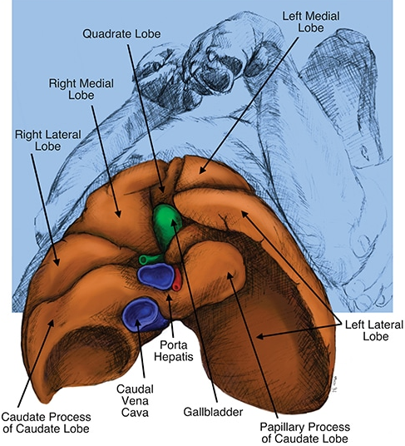
anatomy
Surgery of the liver and extrahepatic biliary tract is challenging areas in small animal surgery because : organs are highly vascular, access is poor because of limited mobility, and hepatic parenchyma is often friable and difficult to suture.
The fissures subdivide the liver of dogs and cats into five lobes, four sublobes, and two processes.
The left lobe is the largest and is subdivided into the left lateral and left medial lobes.

Slide 4
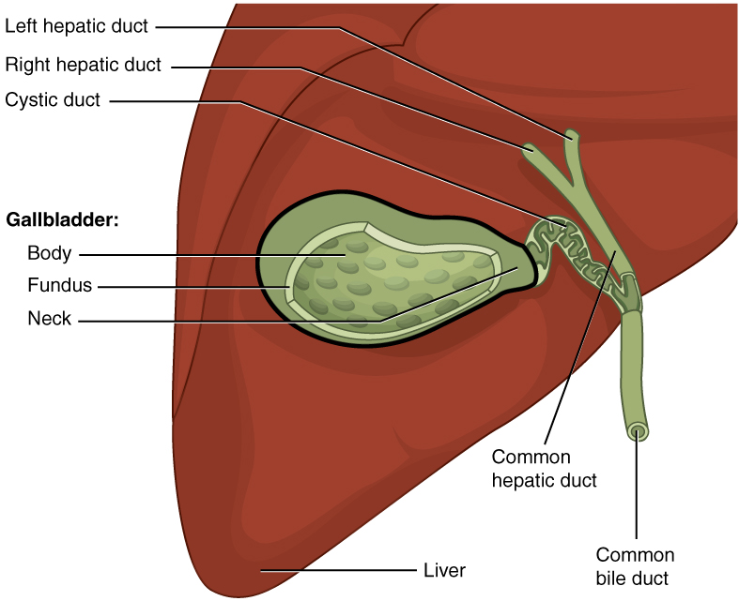
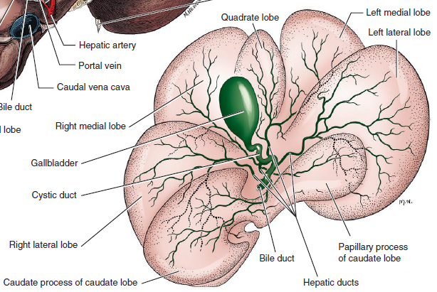
Biliary System
Within the liver, canaliculi drain bile into interlobular ducts. These converge further into lobar ducts that become known as hepatic ducts as they exit the liver parenchyma and form part of the extrahepatic biliary tract
The gallbladder stores and concentrates bile and excretes it into the intestinal tract.
Bile first passes through the cystic duct and common bile duct before entering the duodenum through the sphincter of Oddi.

Slide 5
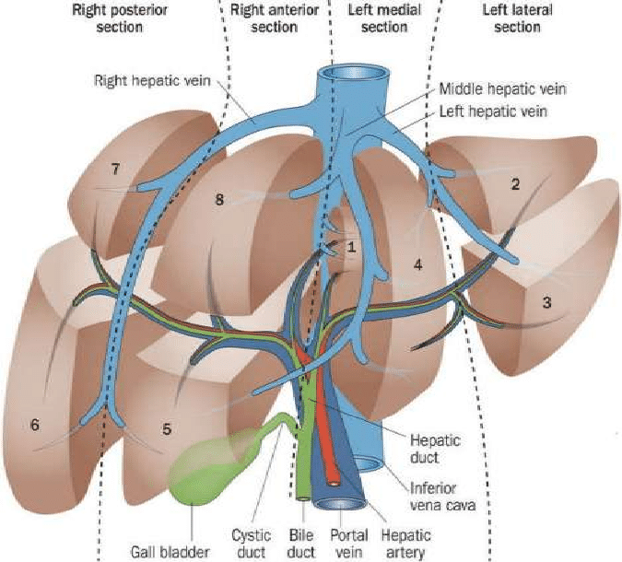
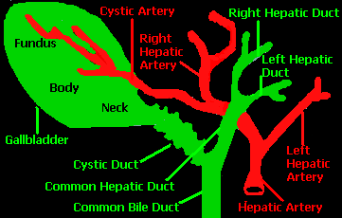
Blood Supply
Blood supply to the liver comes from the hepatic artery, which is a branch of the celiac artery, and the portal vein.
The cystic artery to the gallbladder is a branch of the left branch of the hepatic artery.

Slide 6
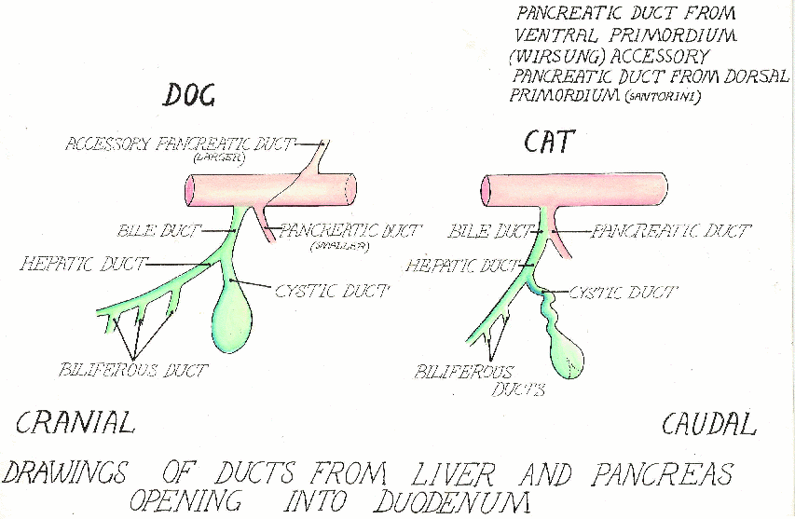
Species Differences

Slide 7
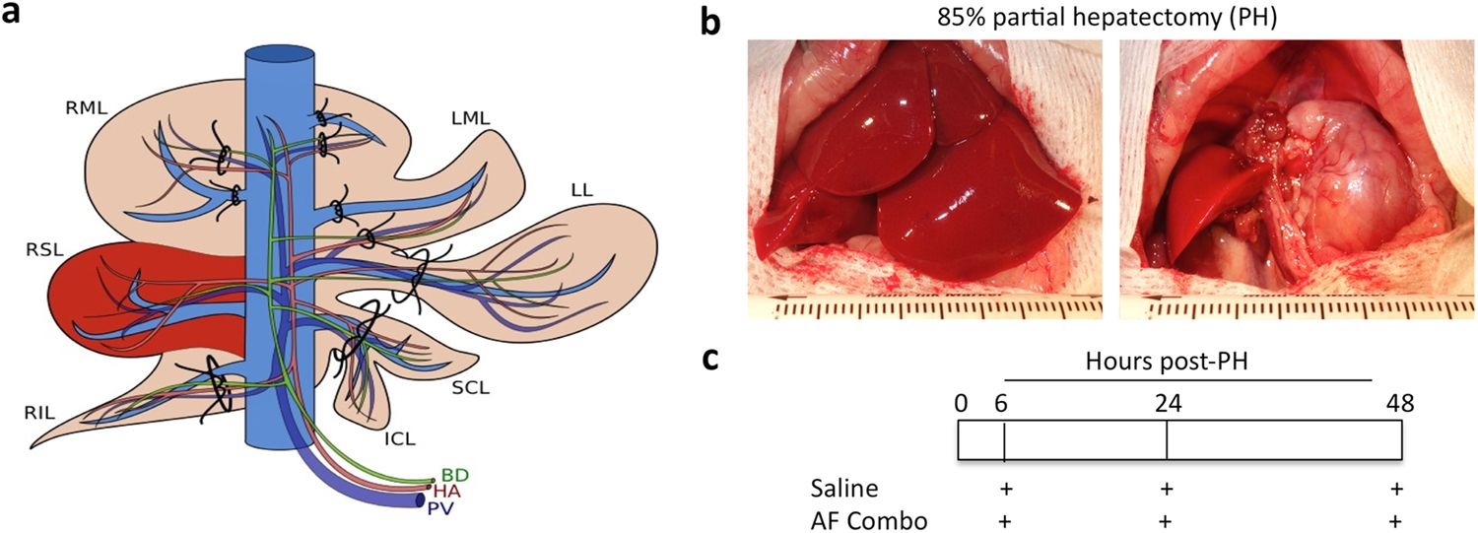
Regenerative Capacity After Hepatic Resection or Injury
Fortunately, the normal liver has an incredible regenerative capacity.
Normal dogs tolerated acute removal of 65% to 70% of total liver volume, but they did not tolerate 84% removal.
Several factors have been identified that reduce hepatic regeneration
Biliary obstruction
Diabetes mellitus
Malnutrition,
older age

Slide 8
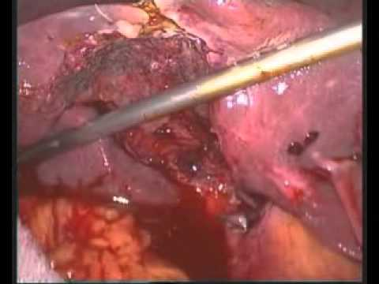
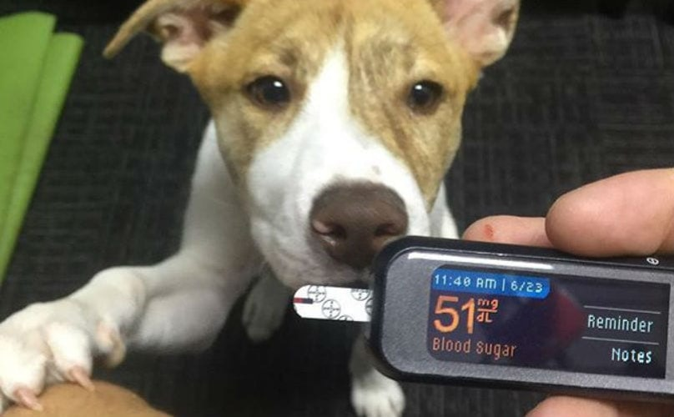
PREOPERATIVE CONSIDERATIONS FOR HEPATIC SURGERY
Hemorrhage
Hypoglycemia
Glucose supplementation should be considered in these patients and for those undergoing extensive hepatectomy.
Hypoglycemia was not associated with liver resection of approximately 50% but can occur when 70% of the parenchyma is removed.

Slide 9
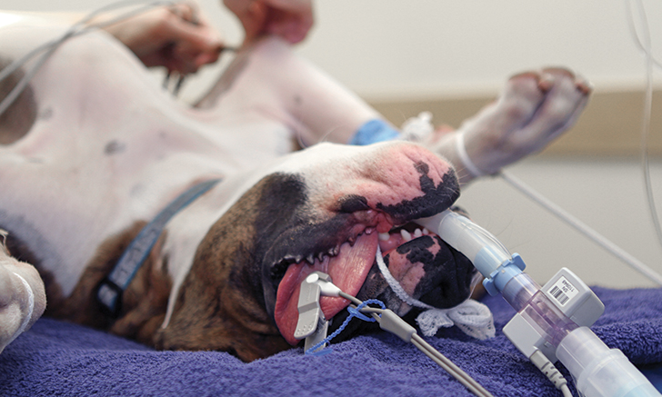
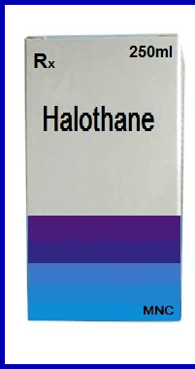
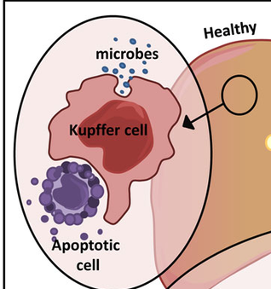
Anesthesia
Drugs undergoing hepatic metabolization should be avoided when possible.
In addition, halothane has been demonstrated to have potential hepatotoxic effects in dogs compared with dogs undergoing isoflurane or sevoflurane anesthesia.
Bacteria
Intestinal bacteria and endotoxins continually delivered through the portal system are normally removed via the liver’s mononuclear phagocytic system, primarily the Kupffer cells.
there remains some controversy regarding the presence of a normal bacterial flora in the canine liver. variety of organisms, including anaerobes, aerobes.

Slide 10
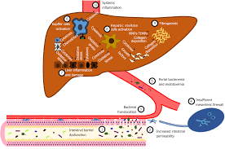
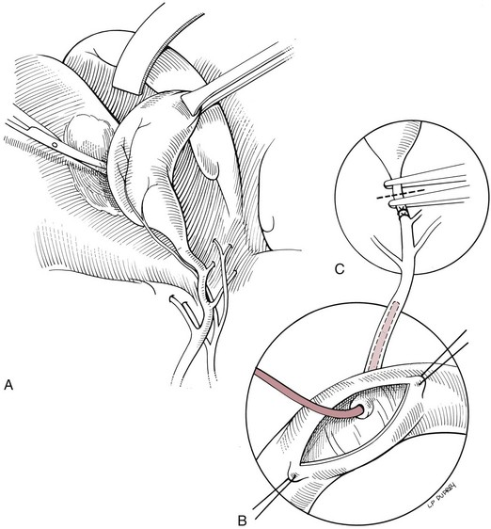
The most common isolate was Clostridium perfringens followed by Staphylococcus spp.
Postoperative broad-spectrum coverage should continue until antimicrobial changes can be made based on individual patient culture and sensitivity testing.
Surgical Procedures of the Extrahepatic Biliary Tract
1. Choledochal Catheterization and Lavage
Catheterization and flushing of the common bile duct are crucial to ensure patency of the duct in many cases of extrahepatic biliary tract disease, especially those with extrahepatic biliary obstruction, gallbladder mucocele, or cholelithiasis.

Slide 11
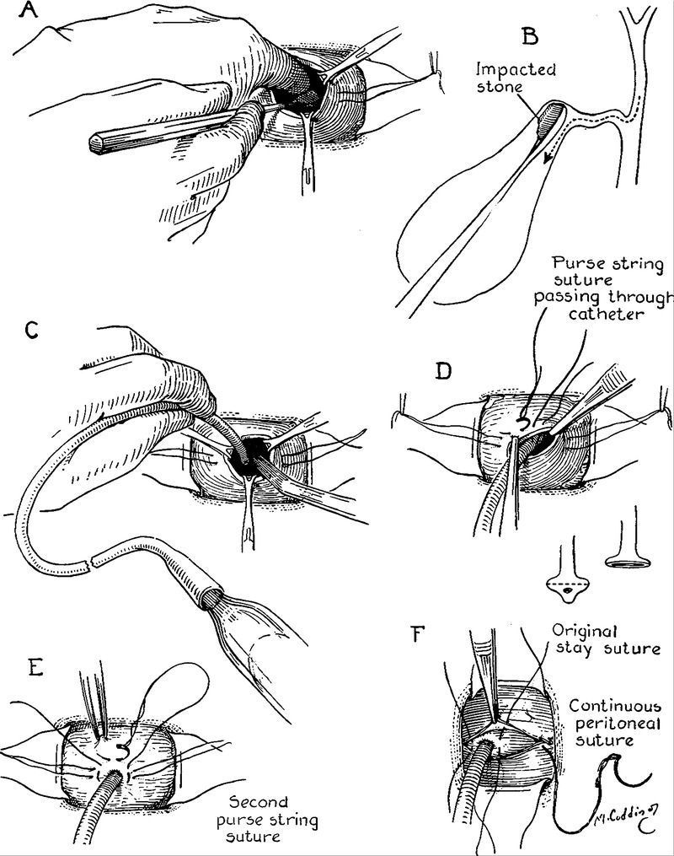
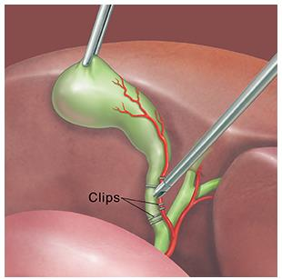
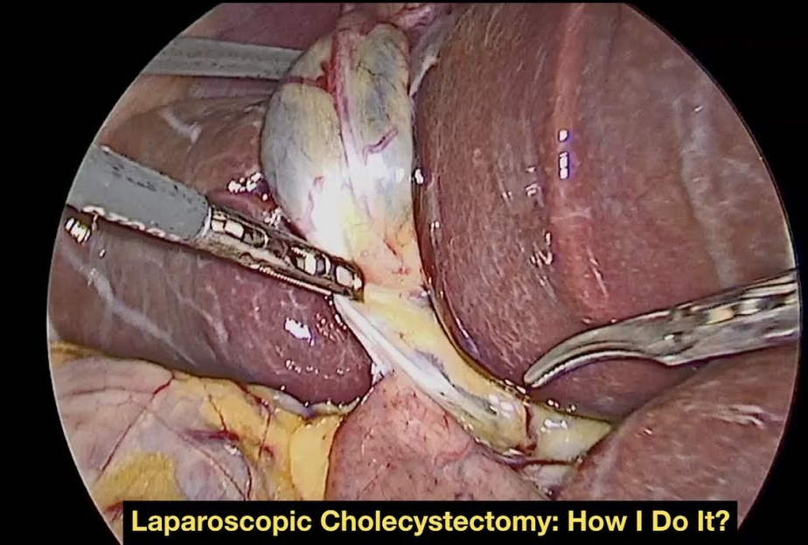
2. Cholecystotomy
Removal of choleliths can be performed by cholecystotomy;
3. Cholecystectomy
Traditional “Open” Cholecystectomy
Before cholecystectomy, the patency of the common bile duct must be confirmed. If performed as part of management of a gallbladder mucocele, flushing the common bile duct to ensure that all gelatinous bile is removed from the common
4. Laparoscopic Cholecystectomy

Slide 12
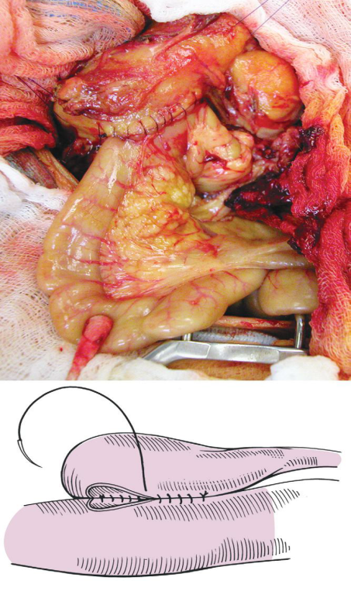
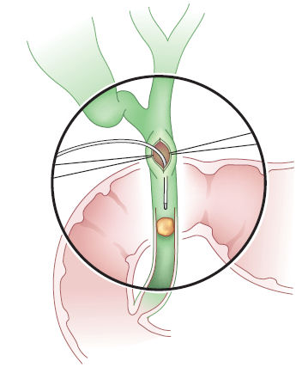
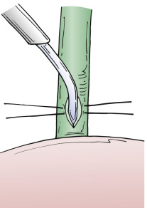
5. Cholecystoenterostomy
Cholecystoduodenostomy and cholecystojejunostomy are the most common techniques used to reroute the biliary system in dogs and cats because the common bile duct is usually too small and friable to permit choledochoduodenostomy.
6. Choledochotomy
Choledochotomy is ideally avoided if there is an alternative because dehiscence is possible because of the thin-walled and often friable nature of the common bile duct in dogs and cats

Slide 13
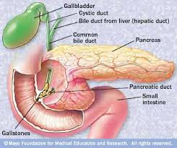
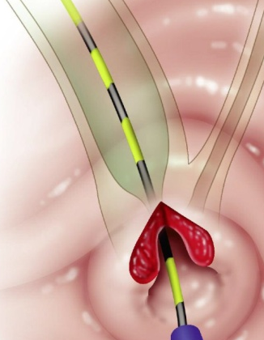
7. Sphincter-Altering Procedures
Occasionally, a cholelith lodged in the terminal common bile duct adjacent to the major duodenal papilla can be removed by sphincterotomy.

Slide 14
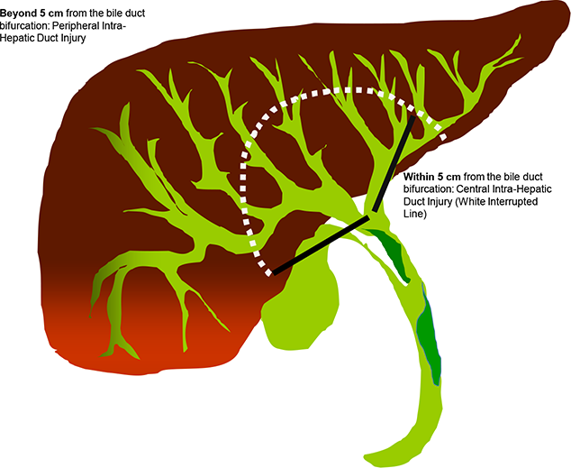
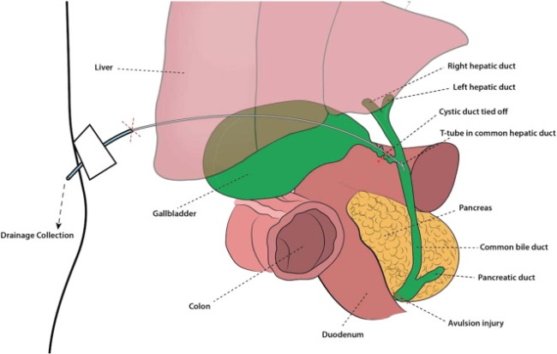
1. Traumatic Biliary Tract Rupture
SPECIFIC DISEASES
The most frequent cause of injury to the extrahepatic biliary tract is blunt abdominal trauma after:
a motor vehicle accident; penetrating wounds from gunshot, stab, or bite injuries have also been reported.
Iatrogenic injury, postoperative leakage from a cholecystotomy, cholecystectomy, or laceration of the common bile duct can also result in leakage and subsequent bile peritonitis.

Slide 15
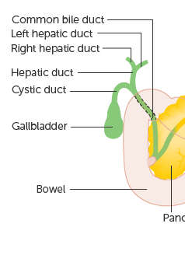
When leakage occurs as a result of blunt trauma, location of the perforation is almost always within the common bile duct or hepatic ducts; rarely, leakage from the gallbladder has been reported.
Tears or transections are usually located within the body of the common bile duct or, less commonly, the cystic duct.
Avulsion injuries of the common bile duct from the duodenum or avulsions of hepatic ducts from the common bile duct are also common

Slide 16
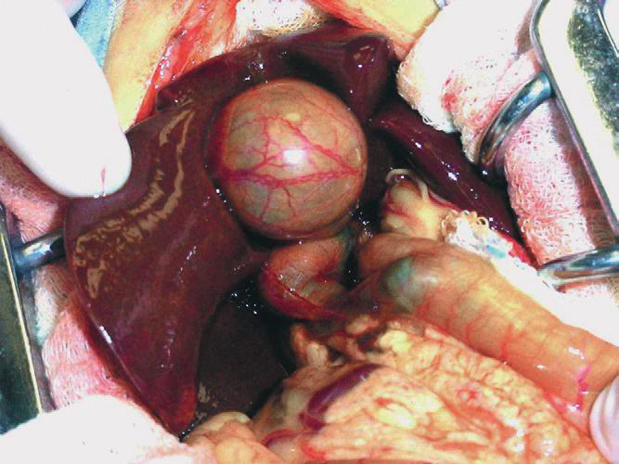
2. Extrahepatic Biliary Obstruction
The most common causes of extrahepatic biliary obstruction in dogs include pancreatitis, neoplasia, gallbladder mucoceles, cholangitis, and cholelithiasis.
Case: Severely icteric tissues can be seen in this cat with extrahepatic biliary tract obstruction. Severe distention of the entire extrahepatic biliary tract is present, and the dark outline of a cholelith can be seen lodged in the distal common bile duct

Slide 17
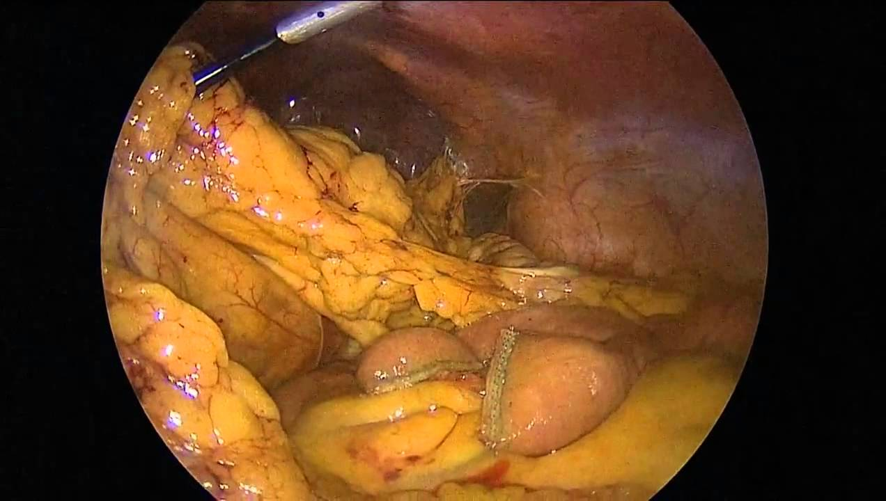
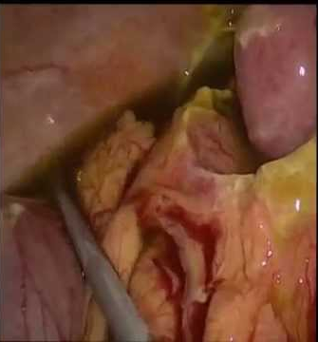
3. Bile Peritonitis
The most common underlying causes of bile peritonitis in dogs are trauma, necrotizing cholecystitis, and ruptured gallbladder mucoceles.
In cats, bile peritonitis is very rare but is usually associated with trauma.
The release of bile salts into the peritoneum is principally responsible for initial pathologic changes that occur with spillage of bile into the peritoneal cavity.
Bile salts cause inflammation, hemolysis, and tissue necrosis. Their hyperosmolality leads to significant fluid shifts from the vascular space into the peritoneal cavity, resulting in dehydration and eventually hypovolemic shock

Slide 18
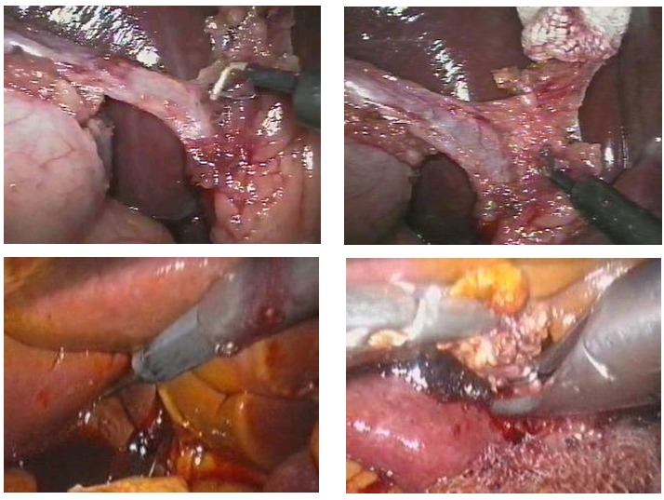
Normal canine bile is sterile; blunt trauma–induced bile leakage is initially more likely to result in sterile peritonitis.
Infection, however, can develop as a result of ascending gastrointestinal contamination, intestinal translocation, or colonization by resident hepatic anaerobes
Bacterial infection profoundly worsens the pathology and subsequent prognosis: multiple studies have demonstrated a significantly higher mortality rate in dogs with septic bile peritonitis compared with those with sterile effusion

Slide 19
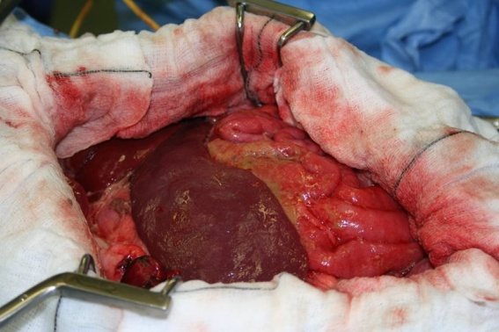
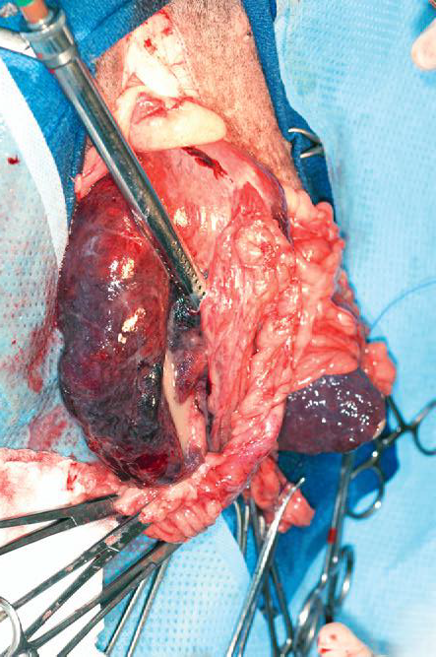
As previously discussed, when bile salts are not present in the lower small intestine to bind endotoxins, systemic endotoxemia may develop, resulting in significant morbidity.
4. Hepatic Abscesses and Cysts
Hepatic abscessation is a relatively uncommon disease in dogs
Diagnosis. Abdominal ultrasonography
Bacterial culture most often identified E. coli,
but various other organisms, including Staphylococcus spp., Enterococcus spp., and Klebsiella spp., were also identified
broad-spectrum antibiotics should be instituted, with changes based on culture and sensitivity results.
Treatment and Outcome.
a combination of medical and sometimes surgical treatments.
systemic antibiotic treatment alone or ultrasound-guided drainage, or surgical resection

Slide 20
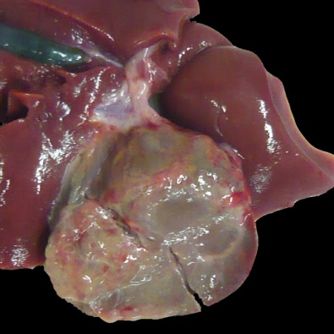
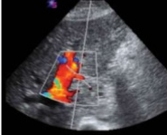
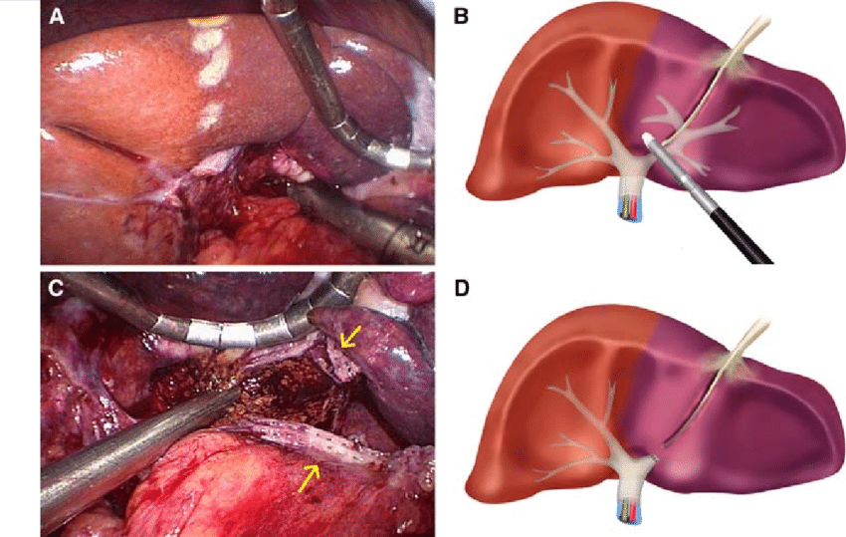
5. Liver Lobe Torsion
Liver lobe torsion is another relatively uncommon disease of dogs,. It is reported most commonly in middle-aged to older large-breed dogs*
Imaging, particularly Doppler ultrasonography, is useful in identifying hepatic vessels with decreased blood flow.
Torsion of the left lateral lobe is most commonly reported, because of its large size, mobility
This condition is considered a surgical emergency to avoid further hepatic necrosis, hepatic abscessation
Treatment is stapled or sutured liver lobectomy.

Slide 21
6. Gallbladder Mucocele
Gallbladder mucocele may currently represent the most common indication for surgical management of extrahepatic biliary tract disease in dogs. It has not yet been convincingly described in cats.
Etiology
The underlying lesion has been described as cystic mucosal hyperplasia. Hypersecretion of mucus leads to an accumulation of thick, gelatinous bile within the gallbladder.

Slide 22
Diagnosis
Diagnosis of gallbladder mucocele relies on a combination of clinical signs, laboratory parameters, and imaging studies.
Treatment
gallbladder mucoceles should be treated surgically is probably justified by the high morbidity and mortality seen in dogs that develop extrahepatic biliary obstruction or bile peritonitis secondary to gallbladder rupture.

Slide 23
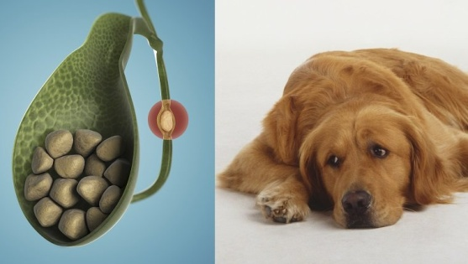
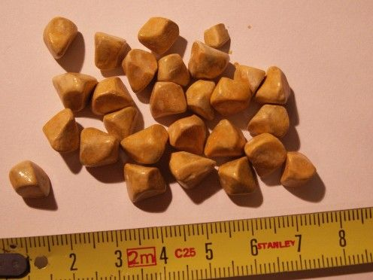
7. Cholelithiasis
Choleliths are fewer than 1% of dogs with biliary tract disease
In contrast to humans, canine bile is less saturated with cholesterol. Cholesterol-containing choleliths are much less common in small animals
In small animals, so called “pigment stones” are more common.
In dogs, they are usually composed primarily of calcium bilirubinate, with bilirubin and cholesterol present in varying quantities.
In cats, most choleliths are calcium carbonate, with calcium bilirubinate and cholesterol reported less frequently.

Slide 24
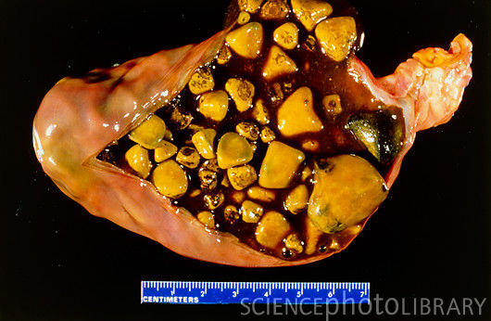
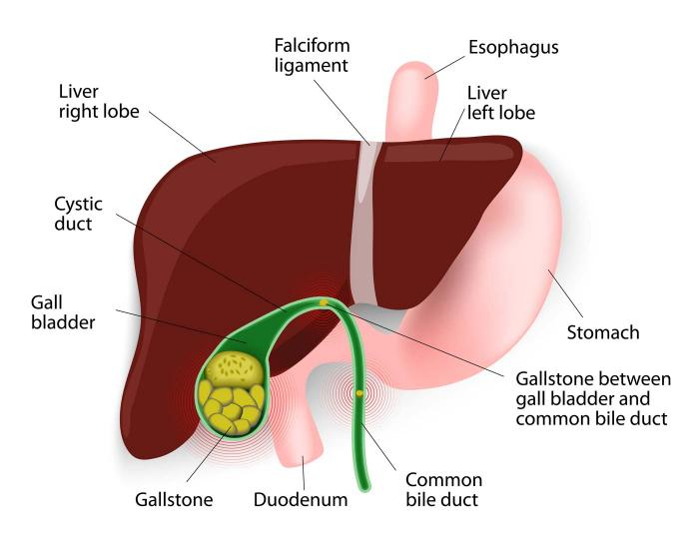
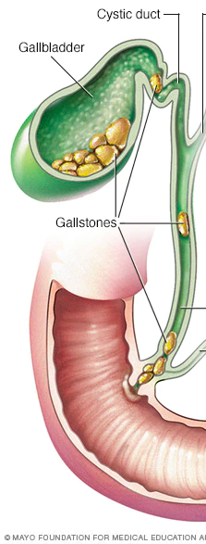
70% of canine choleliths had positive aerobic culture results and 55% had positive anaerobic culture results in one study.
The most common bacteria cultured were E. coli, Streptococcus spp., Enterococcus spp., and Klebsiella spp.
Diagnosis
Most choleliths are formed within the gallbladder,
Abdominal ultrasonography is an effective diagnostic imaging tool for diagnosis of cholelithiasis,
Treatment and Prognosis
Medical dissolution is generally not considered successful.
Bile and cholelith samples should be collected during surgery for aerobic and anaerobic bacterial culture and sensitivity testing.

Slide 25
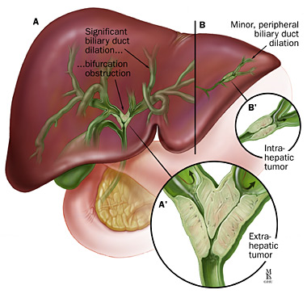
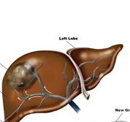
8. Hepatobiliary tumors
Hepatobiliary tumors are of four general types:
hepatocellular (adenomas, hepatocellular carcinomas
cholangiocellular (adenomas, Cholangiocellular carcinoma)
neuroendocrine (carcinoids or amine precursor uptake and decarboxylation (APUD) cell tumors)
mesenchymal (Hemangioma, Primary hepatic hemangiosarcoma, )
Metastatic tumors are more common than primary ones
The most common secondary tumors are hematopoietic and lymphoid tumors followed by epithelial and mesenchymal tumors.

Slide 26
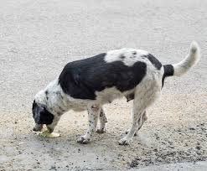
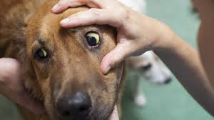
Most animals with hepatobiliary neoplasia are aged 9 to 12 years old at presentation.
Clinical signs, when present, are likely to be nonspecific, with lethargy, anorexia, weight loss, and vomiting being most prevalent.* Physical examination may reveal a palpable abdominal mass,
Other signs may be secondary to hepatic failure and include icterus, poor body condition, or ascites

Slide 27
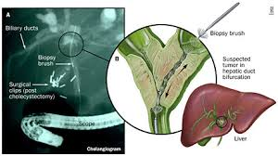
Diagnosis
Plain radiography
Abdominal ultrasonography
aspiration or biopsy of masses is required for histologic diagnosis. Diagnosis of specific tissue types requires fine needle aspiration of cells, needle core biopsy, laparoscopic liver biopsy, or “open” surgical biopsy.
The simplest method for obtaining a diagnosis of hepatic neoplasia is ultrasound-guided fine needle aspiration.
Contrast enhanced harmonic ultrasonography increases the ability to differentiate between benign and malignant hepatic nodules

Slide 28

Good luck

